Slide 1
Sorting Algorithms
Sections 7.1 to 7.7

Slide 2
Comparison-Based Sorting
Input – 2,3,1,15,11,23,1
Output – 1,1,2,3,11,15,23
Class ‘Animals’
  Sort Objects – Rabbit, Cat, Rat ??
    Class must specify how to compare Objects
In general, need the support of
  ‘<‘ and ‘>’ operators

Slide 3
Sorting Definitions
In place sorting
  Sorting of a data structure does not require any external data structure for storing the intermediate steps
External sorting
  Sorting of records not present in memory
Stable sorting
  If the same element is present multiple times, then they retain the original relative order of positions

Slide 4
C++ STL sorting algorithms
sort function template
  void sort(iterator begin, iterator end)
  void sort(iterator begin, iterator end, Comparator cmp)
  begin and end are start and end marker of container (or a range of it)
  Container needs to support random access such as vector
  sort is not stable sorting
    stable_sort() is stable

Slide 5
Heapsort
Min heap
  Build a binary minHeap of N elements
    O(N) time
  Then perform N findMin and deleteMin operations
    log(N) time per deleteMin
  Total complexity O(N log N)
  It requires an extra array to store the results
Max heap
  Storing deleted elements at the end avoid the need for an extra element

Slide 6
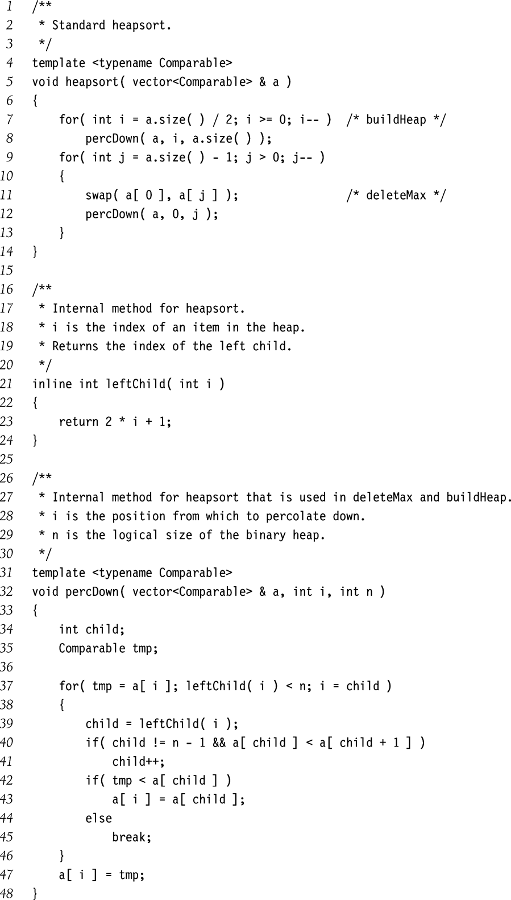
Heapsort Implementation

Slide 7
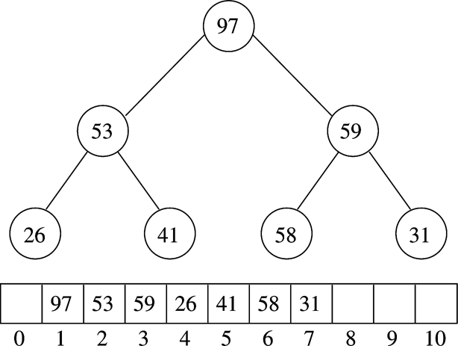
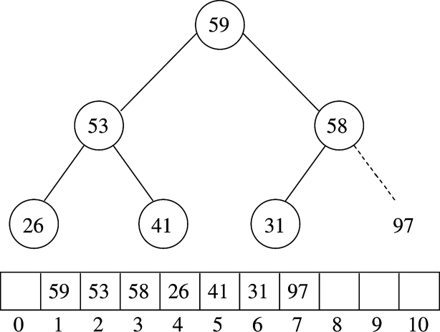
Example (MaxHeap)
After BuildHeap
After first deleteMax

Slide 8
Bubble Sort
Simple and uncomplicated
Compare neighboring elements
Swap if out of order
Two nested loops
O(n²)

Slide 9
Bubble Sort
vector a contains n elements to be sorted.
for (i=0; i<n-1; i++) {
for (j=0; j<n-1-i; j++)
if (a[j+1] < a[j]) { /* compare neighbors */
tmp = a[j]; /* swap a[j] and a[j+1] */
a[j] = a[j+1];
a[j+1] = tmp;
}
}
http://www.ee.unb.ca/petersen/lib/java/bubblesort/

Slide 10
Bubble Sort Example
2, 3, 1, 15
2, 1, 3, 15 // after one loop
1, 2, 3, 15 // after second loop
1, 2, 3, 15 // after third loop

Slide 11
Insertion Sort
O(n²) sort
N-1 passes
  After pass p all elements from 0 to p are sorted
  Following step inserts the next element in correct position within the sorted part

Slide 12
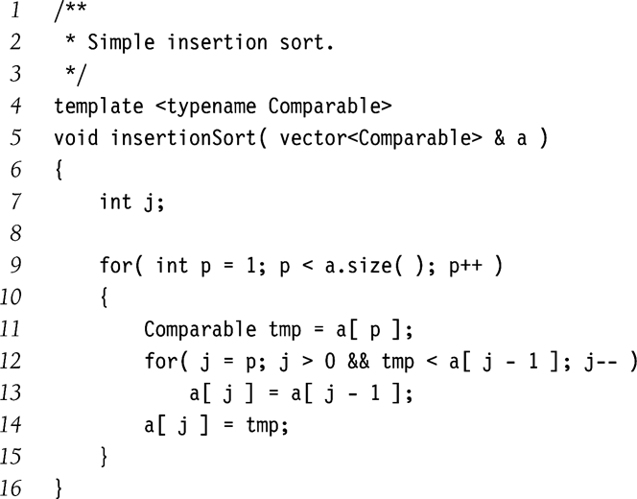
Insertion Sort

Slide 13
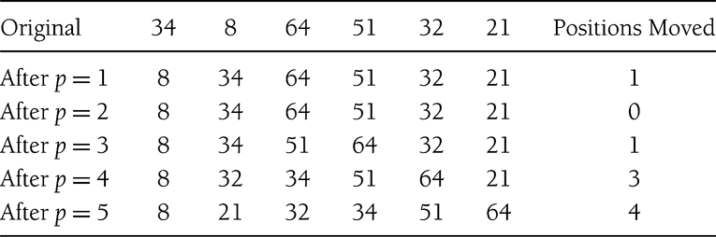
Insertion Sort: Example

Slide 14
Insertion Sort - Analysis
Pass p involves at most p comparisons
Total comparisons = ∑i ; i = [1, n-1]
= O(n²)

Slide 15
Insertion Sort - Analysis
Worst Case ?
  Reverse sorted list
  Max possible number of comparisons
  O(n²)
Best Case ?
  Sorted input
  1 comparison in each pass
  O(n)

Slide 16
Lower Bound on ‘Simple’ Sorting
Simple sorting
  Performing only adjacent exchanges
  Such as bubble sort and insertion sort
Inversions
  an ordered pair (i, j) such that i<j but a[i] > a[j]
  34,8,64,51,32,21
  (34,8), (34,32), (34,21), (64,51) …
Once an array has no inversions it is sorted
So sorting bounds depend on ‘average’ number of inversions performed

Slide 17
Theorem 1
Average number of inversions in an array of N distinct elements is N(N-1)/4
  For any list L, consider reverse list L_{r}
    L: 34, 8, 64, 51, 32, 21
    Lr: 21, 32, 51, 64, 8, 34
  All possible number of pairs is in L and Lr
  = N(N-1)/2
  Average number of inversion in L = N(N-1)/4

Slide 18
Theorem 2
Any algorithm that sorts by exchanging adjacent elements requires Ω(n²) average time
  Average number of inversions = Ω(n²)
  Number of swaps required = Ω(n²)

Slide 19
Bound for Comparison Based Sorting
O( n logn )
  Optimal bound for comparison-based sorting algorithms
  Achieved by Quick Sort, Merge Sort, and Heap Sort

Slide 20
Mergesort
Divide the N values to be sorted into two halves
Recursively sort each half using Mergesort
  Base case N=1 ➔ no sorting required
Merge the two (sorted) halves
  O(N) operation

Slide 21
Merging O(N) Time
1 | 15 | 24 | 26
2 | 13 | 27 | 38
1 | 15 | 24 | 26
2 | 13 | 27 | 38
1
1 | 15 | 24 | 26
2 | 13 | 27 | 38
1 | 2
1 | 15 | 24 | 26
2 | 13 | 27 | 38
1 | 2 | 13
In each step, one element of C gets filled
  Each element takes constant time
  So, total time = O(N)

Slide 22
Mergesort Example
1 | 24 | 26 | 15 | 13 | 2 | 27 | 38
1 | 24 | 26 | 15
13 | 2 | 27 | 38
1 | 24
26 | 15
13 | 2
27 | 38
1
24
26
15
13
2
27
38
1 | 24
15 | 26
2 | 13
27 | 38
1 | 15 | 24 | 26
2 | 13 | 27 | 38
1 | 2 | 13 | 15 | 24 | 26 | 27 | 38

Slide 23
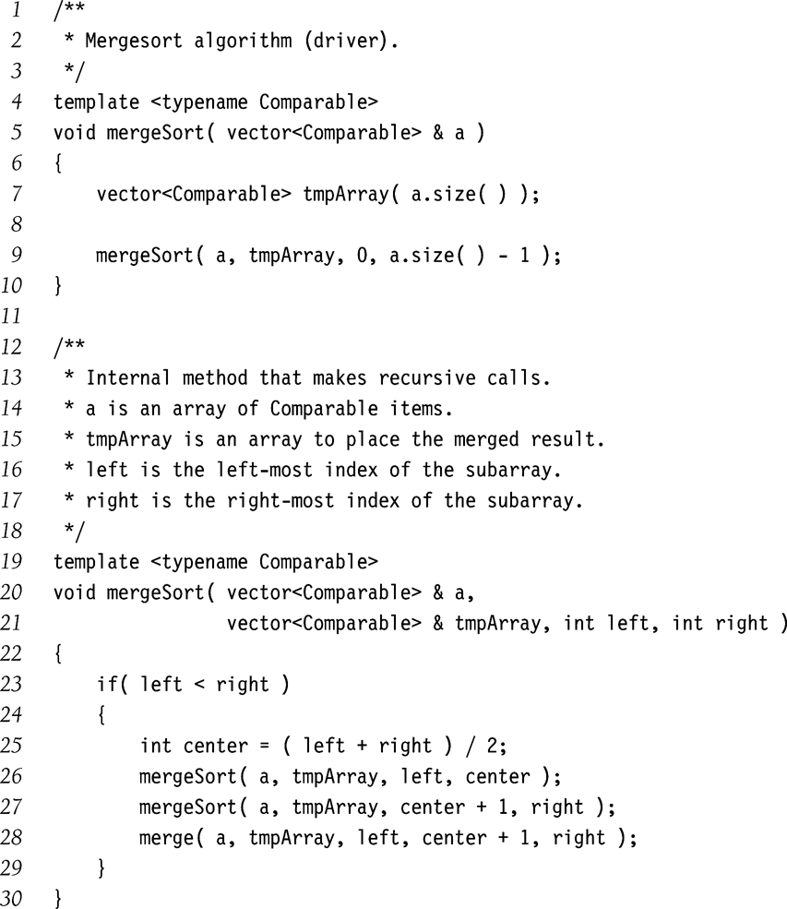
Mergesort Implementation

Slide 24
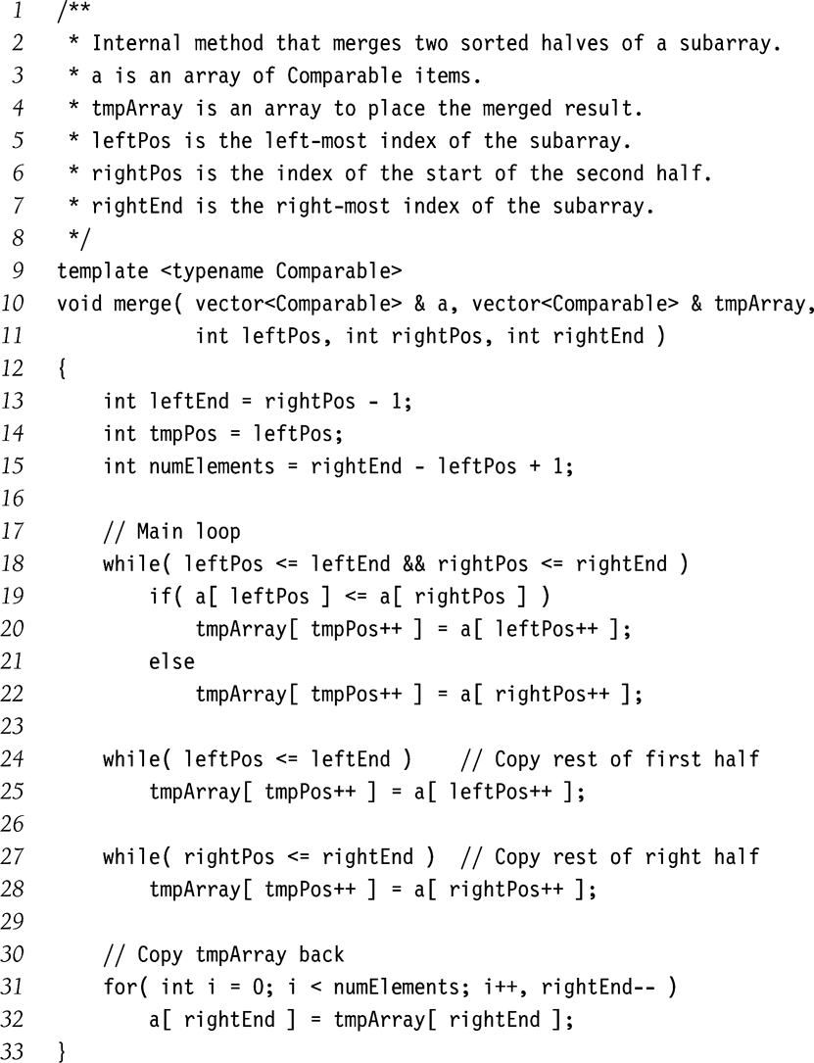

Slide 25
Mergesort Complexity Analysis
Let T(N) be the complexity when size is N
Recurrence relation
  T(1) = 1
  T(N) = 2T(N/2) + N
  T(N) = 4T(N/4) + 2N
  T(N) = 8T(N/8) + 3N
  …
  T(N) = 2^{k}T(N/2^{k}) + k*N
  For k = log N
    T(N) = N T(1) + N log N
Complexity: O(N logN)

Slide 26
Quicksort
Fastest known sorting algorithm in practice
  Caveats: not stable
Average case complexity →O(N log N )
Worst-case complexity → O(N²)
  Rarely happens, if implemented well
http://www.cs.uwaterloo.ca/~bwbecker/sortingDemo/
http://www.cs.ubc.ca/~harrison/Java/

Slide 27
Quicksort Outline
Divide and conquer approach
Given array S to be sorted
  If size of S < 1 then done;
  Pick any element v in S as the pivot
  Partition S-{v} (remaining elements in S) into two groups
    S1 = {all elements in S-{v} that are smaller than v}
    S2 = {all elements in S-{v} that are larger than v}
  Return {quicksort(S1) followed by v followed by quicksort(S2) }
Trick lies in handling the partitioning (step 3).
  Picking a good pivot
  Efficiently partitioning in-place

Slide 28
Quicksort Example
81
43
31
57
75
13
92
65
26
0
Select pivot
81
43
31
57
75
13
65
26
0
92
partition
13
31
57
65
81
43
26
0
92
75
Recursive call
Recursive call
0
13
26
31
43
57
75
81
92
Merge
0
13
26
31
43
57
65
75
81
92

Slide 29
Quicksort Structure
What is the time complexity if the pivot is always the median?
  Note: Partitioning can be performed in O(N) time
What is the worst case height

Slide 30
Picking the Pivot
How would you pick one?
Strategy 1: Pick the first element in S
  Works only if input is random
  What if input S is sorted, or even mostly sorted?
    All the remaining elements would go into either S1 or S2!
    Terrible performance!

Slide 31
Picking the Pivot (contd.)
Strategy 2: Pick the pivot randomly
  Would usually work well, even for mostly sorted input
  Unless the random number generator is not quite random!
  Plus random number generation is an expensive operation

Slide 32
Picking the Pivot (contd.)
Strategy 3: Median-of-three Partitioning
  Ideally, the pivot should be the median of input array S
    Median = element in the middle of the sorted sequence
  Would divide the input into two almost equal partitions
  Unfortunately, its hard to calculate median quickly, even though it can be done in O(N) time!
  So, find the approximate median
    Pivot = median of the left-most, right-most and center element of the array S
    Solves the problem of sorted input

Slide 33
Picking the Pivot (contd.)
Example: Median-of-three Partitioning
  Let input S = {6, 1, 4, 9, 0, 3, 5, 2, 7, 8}
  left=0 and S[left] = 6
  right=9 and S[right] = 8
  center = (left+right)/2 = 4 and S[center] = 0
  Pivot
    = Median of S[left], S[right], and S[center]
    = median of 6, 8, and 0
    = S[left] = 6

Slide 34
Partitioning Algorithm
Original input : S = {6, 1, 4, 9, 0, 3, 5, 2, 7, 8}
Get the pivot out of the way by swapping it with the last element
Have two ‘iterators’ – i and j
  i starts at first element and moves forward
  j starts at last element and moves backwards
8 1 4 9 0 3 5 2 7 6
pivot
8 1 4 9 0 3 5 2 7 6
i
j
pivot

Slide 35
Partitioning Algorithm (contd.)
While (i < j)
  Move i to the right till we find a number greater than pivot
  Move j to the left till we find a number smaller than pivot
  If (i < j) swap(S[i], S[j])
  (The effect is to push larger elements to the right and smaller elements to the left)
Swap the pivot with S[i]

Slide 36
Partitioning Algorithm Illustrated
i
j
pivot
8 1 4 9 0 3 5 2 7 6
Move
i
j
pivot
8 1 4 9 0 3 5 2 7 6
swap
i
j
pivot
2 1 4 9 0 3 5 8 7 6
move
i
j
pivot
2 1 4 9 0 3 5 8 7 6
swap
i
j
pivot
2 1 4 5 0 3 9 8 7 6
move
j
i
pivot
i and j
have crossed
2 1 4 5 0 3 9 8 7 6
Swap S[i]
with pivot
2 1 4 5 0 3 6 8 7 9
j
i
pivot

Slide 37
Dealing with small arrays
For small arrays (say, N ≤ 20),
  Insertion sort is faster than quicksort
Quicksort is recursive
  So it can spend a lot of time sorting small arrays
Hybrid algorithm:
  Switch to using insertion sort when problem size is small
  (say for N < 20)

Slide 38
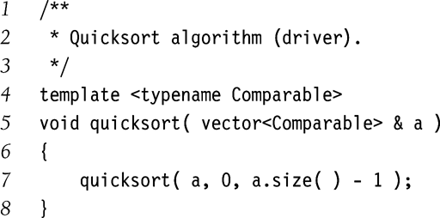
Quicksort Driver Routine

Slide 39
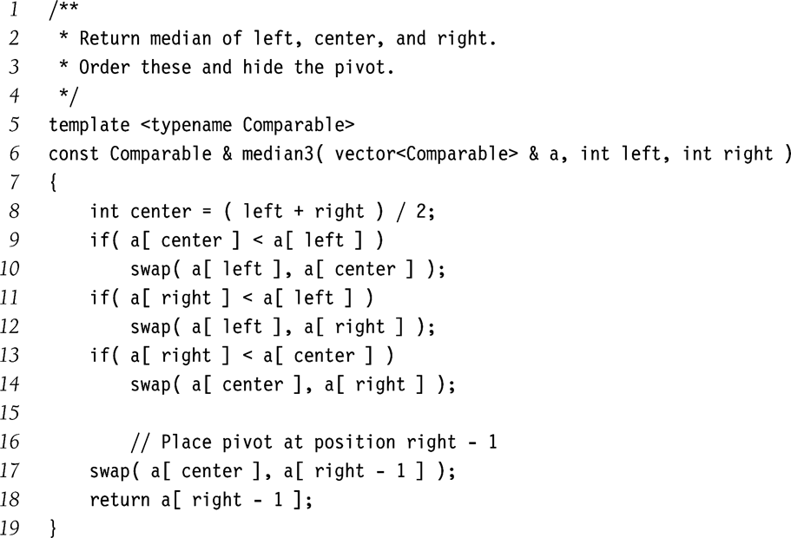
Quicksort Pivot Selection Routine
Swap a[left], a[center]
and a[right] in-place
Pivot is in a[center] now
Swap the pivot a[center]
with a[right-1]

Slide 40
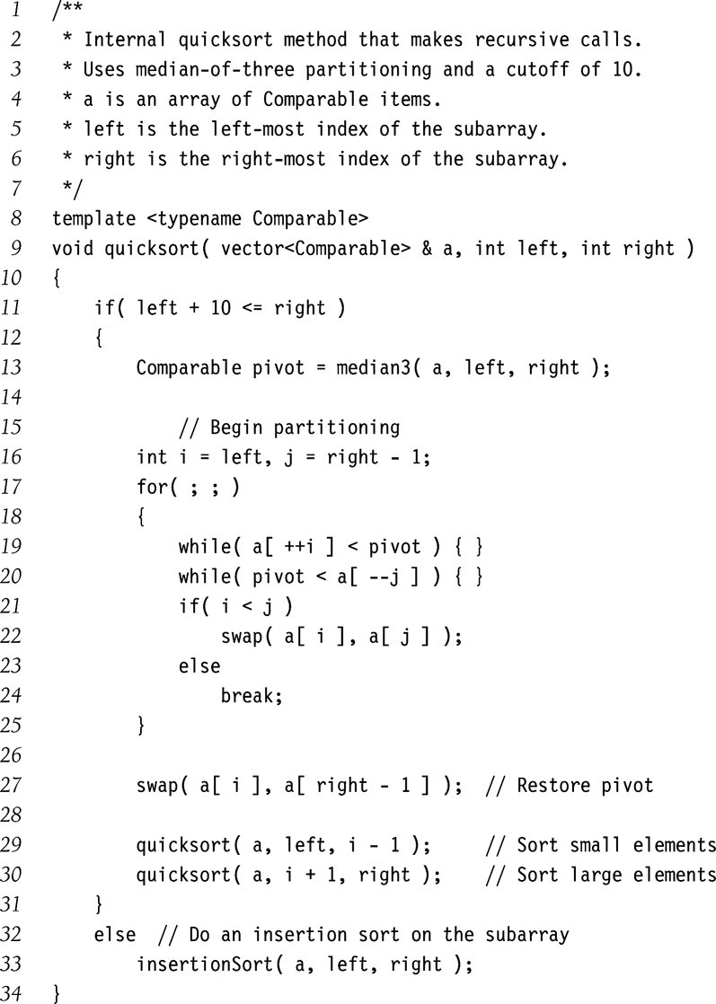
Quicksort routine
Has a side effect
move
swap

